Slide 1

Chapter no. 3: Lists
This chapter will help the reader understand the following concepts:
Creating a list
Accessing and manipulating list elements
Merging lists
Converting lists to vectors

Slide 2
List
A list in R constitutes of different objects such as strings, numbers, and vectors.
it can include another list within it.
It can also include matrices and functions.

Slide 3
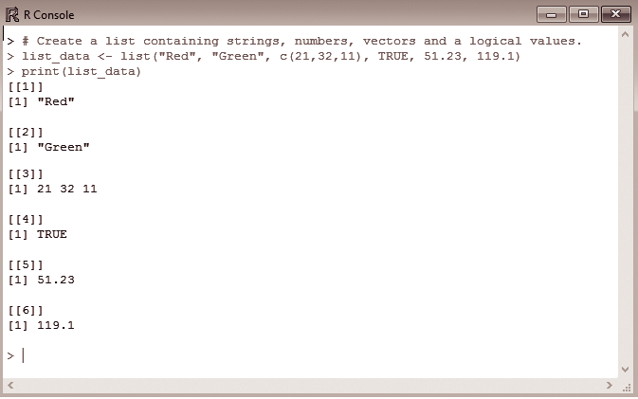
Creating a List
A list can be created using the list() function.
Figure demonstrates the creation of an anonymous list list_data, containing strings, numbers, vectors, and logical values as data objects, And also use print statement to print it.

Slide 4
Creating a named List
Lists in R have a special property wherein names can be assigned to the previously defined set of elements in the list.
Named lists can be created using the names() function.

Slide 5
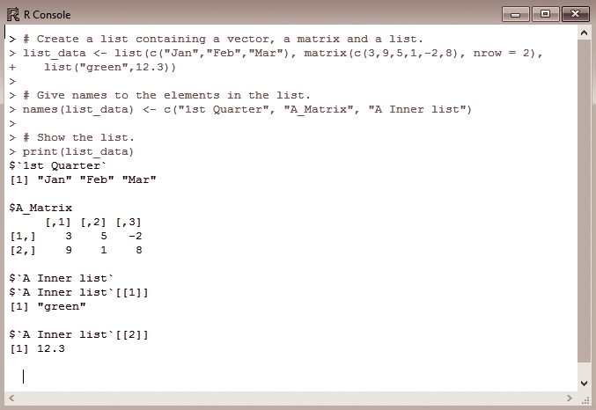
Write the command in R console to create a list containing a vector, a
matrix, and a list. Also give names to the elements in the list and display
the list.
creates a named list using the names() function.
First a list called list_data containing a vector and a matrix and another list called list are created.
The created list is viewed using the print statement.

Slide 6
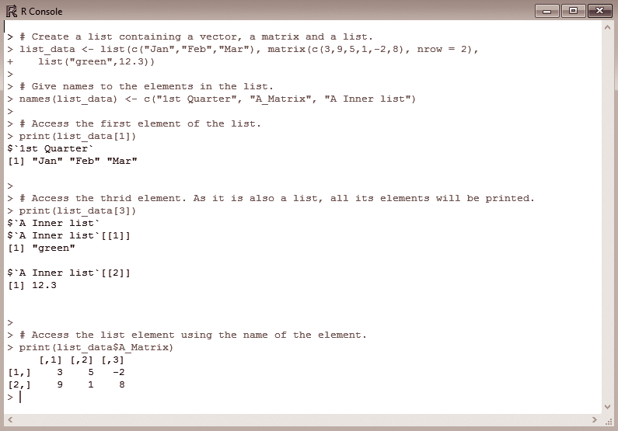
Accessing List elements
The elements can be accessed using the index value of that element. For a
named list, the elements are accessed based on their names.
In Fig., to access the first element from list_data, the index value of the list
is accessed; here the list elements are indexed starting from 1 and not from
0. Therefore printing list_data[1] gives the names of the first and later
elements in the list.

Slide 7
Manipulating List elements
Addition, deletion, and updating operations can be performed on the list to
manipulate the elements.
Elements can be added and deleted only at the end of the list
update operation can be performed on any element in the list irrespective of its
position

Slide 8
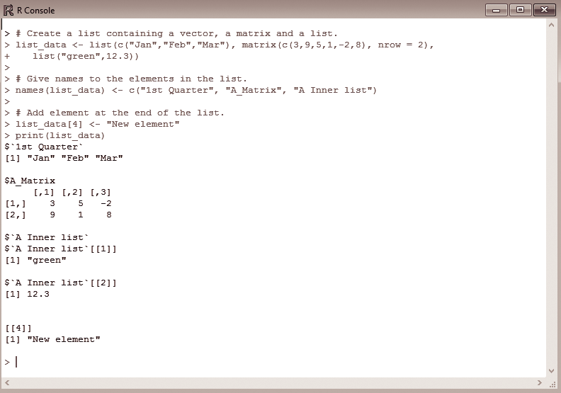
Write the command in R console to add a new element
at the end of the list and display the same.
Fig depicts the addition of an element to a list.
Assume list consists of only three elements. To add the fourth element to this list, append the element (which is a string here) “New element” to the 4th indexed position of the list, that is, list_data[4].
To view the added element in the list, print the list and the four elements are displayed.

Slide 9
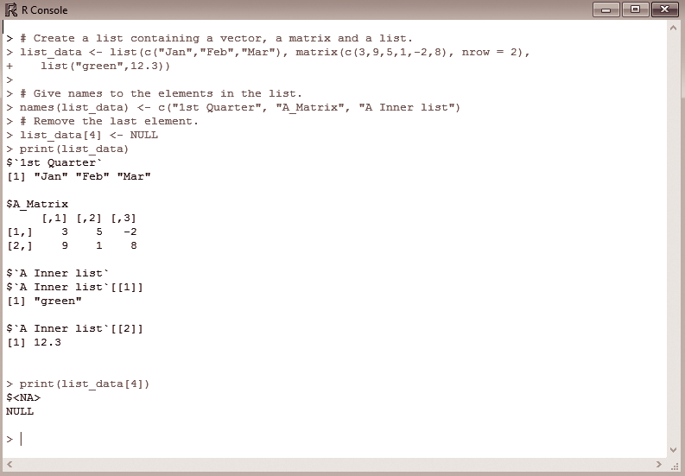
Write the command in R console to delete the fourth element
from a list and display the resultant list.
Fig. , the fourth element, “New element” can be deleted by setting its value
to NULL.
Printing list_data shows only three elements in the list

Slide 10
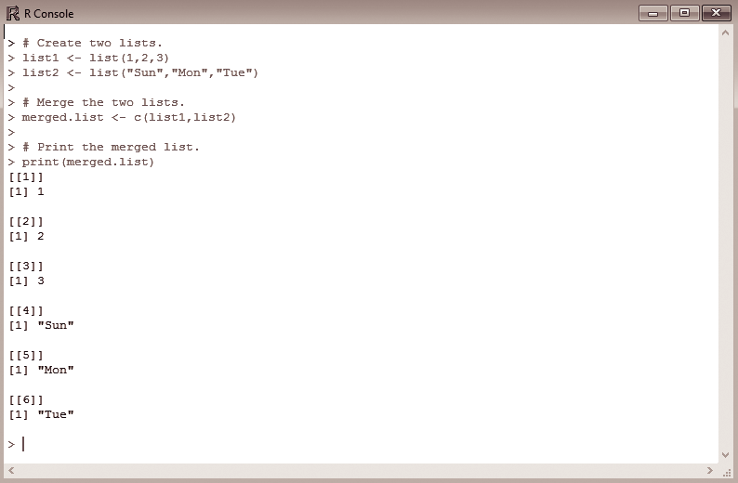
Merging Lists
Multiple lists can be merged by placing all those lists in a single list() function.
Figure, shows two lists list1 and list2 created using the list() function.
placing them in a single list() function gives a merged list called merged.list, which
contains the elements of both the lists placed sequentially.

Slide 11
Converting Lists to vectors
There are some special cases where lists are converted to vectors for
further manipulation of the data elements.
This is done because in addition to the basic operations of add, delete, and update, there are other arithmetic operations that can be easily applied when the operands are in vector form.
A special function called unlist() is used ; this function takes the input as list and produces vectors

Slide 12
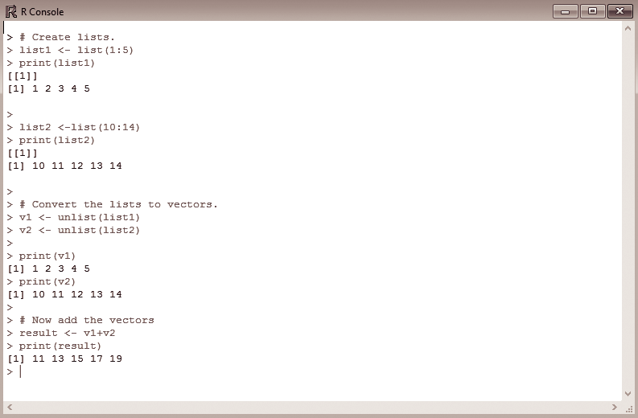
Write the command in R console to create two lists, each containing 5
elements. Convert the lists into vectors and perform addition on the two
vectors. Display the resultant vector.
Here two lists namely, list1 and list2 are initially created.
Later with the help of the unlist() function, both the lists are converted to vectors named v1 and v2

Slide 13
Chapter 4: Conditionals and control Flow
This chapter will help the reader understand the following concepts:
Relational operators
Logical operators—and, or, not
Operators and vectors
Conditional statements

Slide 14
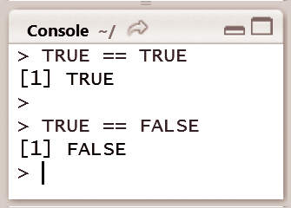
Relational operators
Relational operators are comparators that help us understand how one object relates to another.
For example, to check whether two objects are equal, the double equal operator can be used to check if the logical value TRUE equals the logical value TRUE (TRUE == TRUE) and the result is a logical value
Logical variables can also be used to check the quality of other types, which compares strings and numbers

Slide 15
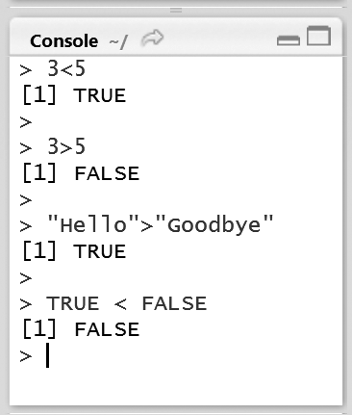
These are the steps needed to be done to check if an object is
lesser than or greater than another object.
In the case of numerical values 3 < 5 will evaluate to TRUE and 3 > 5 will evaluate to FALSE.
For character strings and logical values, R uses the alphabetic order to sort character strings
For logical values is TRUE < FALSE evaluates to FALSE, since TRUE
corresponds to 1 and FALSE corresponds to 0

Slide 16
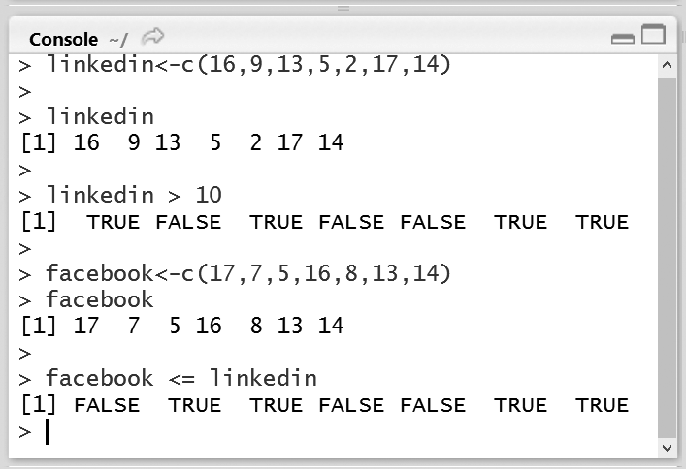
Relational operators and Vectors
Consider a scenario for recording the number of views of a LinkedIn profile per day using the vector linkedin, shown in Fig
For example, to find out on which days the number of views exceeded 10, use the greater than (>) operator,here these elements the result will be TRUE.
Vectors can also be compared with other vectors. A record of the number of facebook user profiles for the previous week is available, which can be saved in another vector called facebook.

Slide 17
logical operators
To change the combined results of comparisons, R uses the logical operators—AND (&), OR (|) and NOT (!).

Slide 18
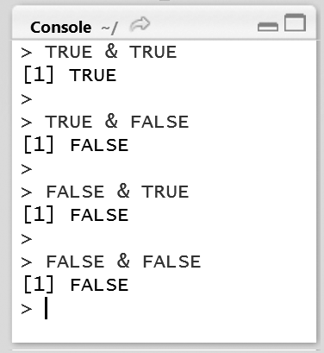
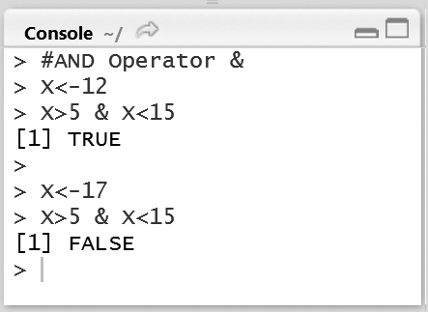
AND operator
The AND operator takes two logical values and returns TRUE only if both these
logical values are each TRUE
•Instead of using logical values, the results of comparisons can be used

Slide 19
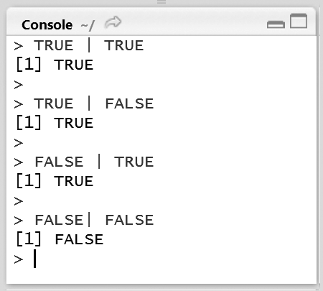
OR operator
The OR operator works similar to the AND operator with a difference that at least one of the logical values should be TRUE for the entire operation to evaluate to TRUE.

Slide 20
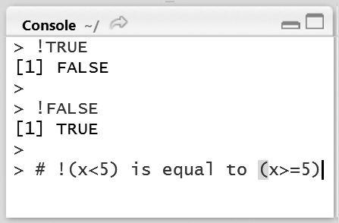
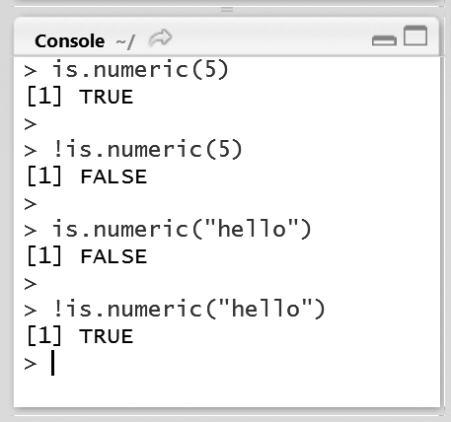
NOT operator
The NOT operator represented by ! simply negates the given logical value

Slide 21
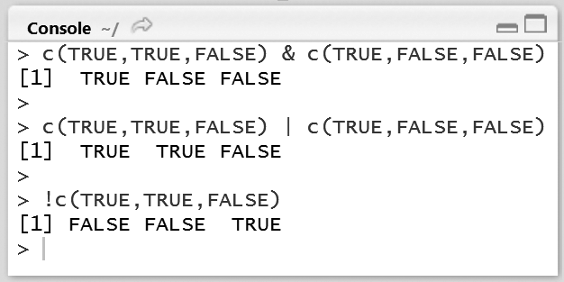
logical operators and Vectors
The working of logical operators with vectors and matrices is similar to that of the
relational operators; the operations are performed element-wise.
Fig., where two vectors with the elements TRUE, TRUE, FALSE and TRUE, FALSE, FALSE are taken. AND operation on these vectors results in a vector with the elements TRUE, FALSE, and FALSE

Slide 22
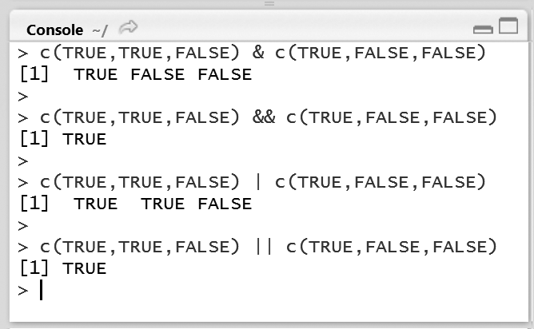
& Vs &&, | Vs ||
There are two versions of the AND and OR operators, namely the single operator
and the double operator versions.
Fig. , as inputs, the first expression evaluates to a vector containing TRUE, FALSE, and FALSE. However if && is used, the result will be TRUE, since the && operator only examines the first element

Slide 23
conditional statements
If-else
If-else if-else

Slide 24
If-else statements
The syntax of an if statement contains a condition; if the condition
evaluates to TRUE, the R code associated with the if statement is executed, the condition appears inside parentheses
Syntax:
if(condition) { expression
}
•if-else statement, the code associated with the else statement gets executed whenever the
condition of the if statement is not satisfied.
Syntax:
if(condition) { expression 1
}
else {
}
expression 2

Slide 25
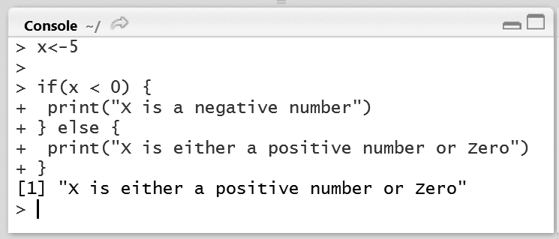
Figure shows an if condition that checks if X is less than zero.
It prints “X is either a positive number or zero” whenever the condition is not met.
Changing X to 5, the condition is not satisfied and prints the expression following the else
statement.

Slide 26
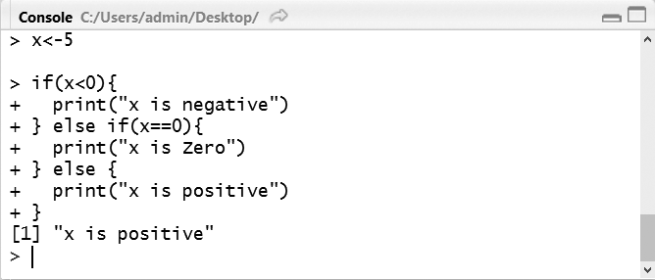
If-else if-else statements
The else if statement comes in between the if and else statements.
Syntax: if(condition1) { expression 1
}else if(condition2) { expression 2
} else {expression 3
}

Slide 27
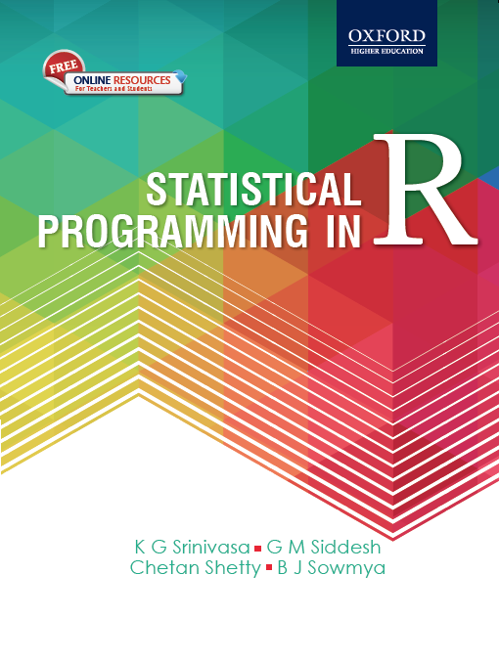

1
Statistical Programming in R
Srinivasa, Siddesh, Shetty & Sowmya

Slide 28
5: Iterative programming in R
Objectives
While and for loops
Loops for vectors, matrices, data frames, and lists

Slide 29
5.1 Introduction
Necessity of iterative statements
These include for and while loops

Slide 30
5.2 While Loop
The syntax for the while loop consists of test_expression that acts as the minimal condition for the loop to check how many times it has to be executed
while(test_expression){
statement
}

Slide 31
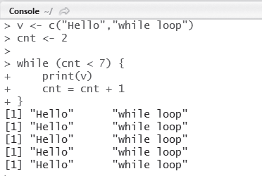
Example
Write an R program to print the values in vectors using the while loop.
Fig. 5.1 Hello world using while loop

Slide 32
5.3 For Loop
The syntax of for loop consists of variable that can be used inside the loop for iterating over the list of elements in a vector or a list.
for (variable in start:end){
statement
}

Slide 33
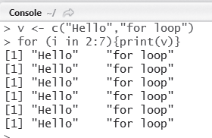
Example
Write an R program to print the values in vectors using the for loop.
Fig. 5.2 Hello world using for loop

Slide 34
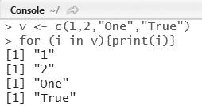
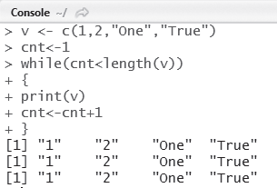
5.4 Looping Over List
L oops for Vectors
Fig. 5.3 Vectors using for loop
Fig. 5.4 Printing vectors using while loop

Slide 35
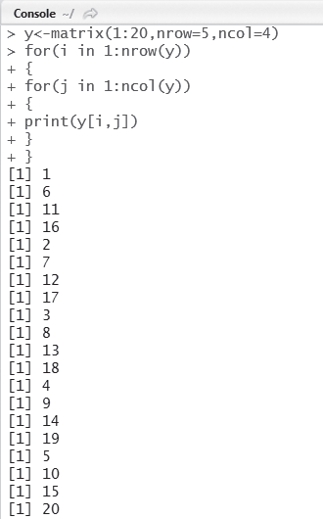
Loops for Matrices
A matrix can be created in R using the matrix() function
Fig. 5.5 Printing the elements of a matrix using for loop

Slide 36
L oops for Data Frames
A data frame in R consists of a group of vectors
It is created using the data.frame() function
Example
Write an R program to create four vectors namely patientid, age, diabetes, and status. Put these four vectors into a data frame patientdata and print the values using a for loop
10

Slide 37
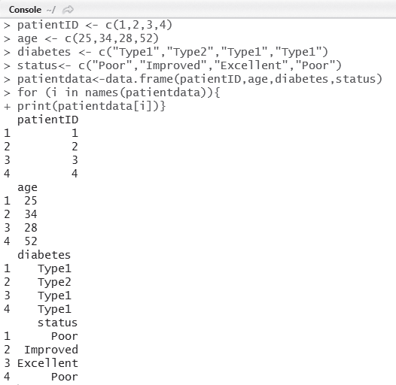
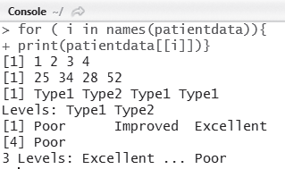
Listing the contents of data.frame()
Creation of data.frame()

Slide 38
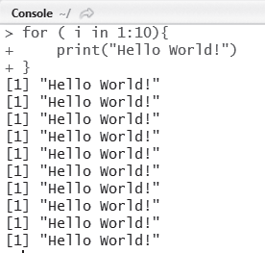
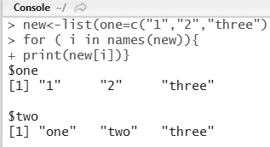
Loops for Lists
•Write an R program to print HELLO 10 times using the for loop.
Creation of list()
Printing HELLO 10 times

Slide 39

1
Statistical Programming in R
Srinivasa, Siddesh, Shetty & Sowmya

Slide 40
6: Functions in R
Learning Objectives
Scope and environment of functions, nested functions, mathematical, and cumulative
functions
Applications of functions—quicksort, binary search trees, recursion
Loading an R package
Calculus in R
Input and output operations

Slide 41
6.1: Introduction
A function is a block or chunk of code having a specific structure, which is often singular or atomic in nature and can be reused to accomplish a specific task.
Functions serve as tools to repeatedly execute certain complex instructions coupled together, since they are self-contained
A function has:
an input(in the form of arguments)
a task (set of statements or lines of code)
an output (a return value).
A function is known by many names in various programming languages such as methods, procedures, and sub-routines.

Slide 42
6.2: Writing a Function in R
The structure of a function in R is similar to that of most of other programming languages which looks something like this:
function_name <- function(arguments)
{
computations on the arguments task-specific code statements
}

Slide 43
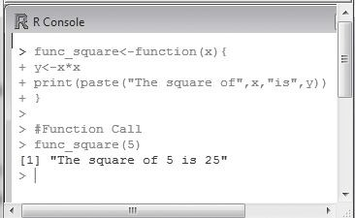
Figure 6.1 illustrates a simple example to create a user-defined function to
compute the square of an integer in R.
Fig. 6.1 User-defined function in R

Slide 44
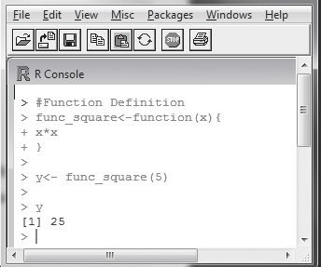
The method shown in Fig. 6.2 does not make use of the ‘return’ keyword
explicitly.
Fig. 6.2 Returning value from function in R

Slide 45
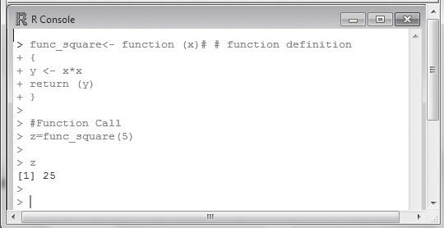
In Fig. 6.3, the return keyword is used and the returned value is stored in a variable using the = sign.
Fig. 6.3 Returning the value using return keyword

Slide 46
6.3: Nested Functions
R allows defining a function inside a function, which is commonly known as nesting of functions. Function nesting can be achieved by defining one function inside another, or by calling one function from another.
For example,
first_func <- function (arguments1)
{
computational code on arguments of first_func
task-specific statements
second_func <- function (arguments2)
{
computational code on arguments of second_func task-specific statements
return statement 2 (if any)
}
rest of function body return statement 1 (if any)
}

Slide 47
The same effect as that of the aforementioned code can be achieved in the following manner:
second_func <- function (arguments2)
{
computational code on arguments of second_func task-specific statements
return statement 2 (if any)
}
first_func <- function (arguments1)
{
computational code on arguments of first_func task-specific statements
my_value <- second_func (arguments2)
rest of function body
return statement 1 (if any)
}

Slide 48
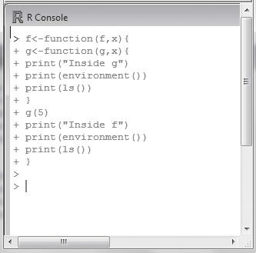
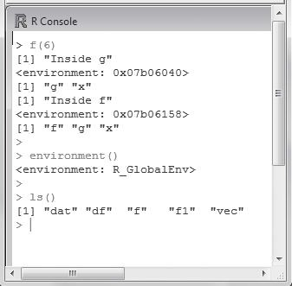
6.4 Function Scoping
The notion of environment and scope is impor
Function Environment
The first thing that gets created when the R interpretation begins is its environment. All variables defined in the R script are the part of this environment and are listed as environment variables as shown in Fig.
10

Slide 49
Function Scope
Scoping is the set of rules that governs how R looks up the value of a symbol
Global variables are those that are available throughout the program changes are reflected in all further references to that variable
A variable defined in a function is not accessible outside the function. It is released when the function ends.

Slide 50
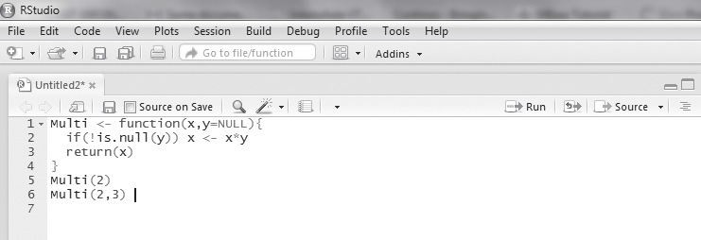
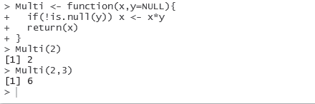
Default Values for Arguments
the concept of a default value is legal
The default argument value can be passed only once
The value of the default argument needs to be declared while declaring the function.
Example 6.2 Write a program to multiply two numbers using a function with a default
value. Assuming default value as NULL.

Slide 51
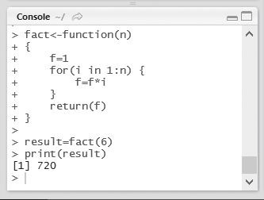
6.5 Recursion
Recursion is a technique where a function calls itself. The concept of recursion is most used when a large problem needs to be broken down into simpler sub-problems in order to simplify the complexity of computation.
The factorial of a number n is denoted by n! and is defined as n! = n x n x (n – 1) x (n – 2) x … x 2 x 1
Following this definition, 6! = 6 x 5 x 4 x 3 x 2 x 1 = 720
20

Slide 52
6.6 Loading an R Package
R comes with numerous packages that are made available to install R onto the
computer.
packages need to be first loaded into the workspace
library(package_name)
To unload a package from the workspace, the following statement is used
detach(package: package_name)
Methods of Loading
Loading a package is fairly simple in R. This can be done using the following statement:
install.packages(“package_name”)
Example:
install.packages(“ggplot”)
following two commands are used to include the packages:
install.packages(“ggplot2”, lib=”/data/Rpackages/”) library(ggplot2, lib.loc=”/data/Rpackages/”)

Slide 53

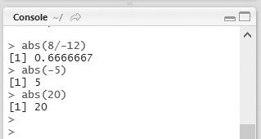
6.7 Mathematical Functions in R
R provides a large number of mathematical and statistical functions to perform easy calculations.
abs(numeric) This function takes in a numeric value and returns the absolute value of
the input. This operation is equivalent to finding the mod of a number.
Fig. 6.25 Absolute value

Slide 54
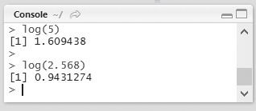
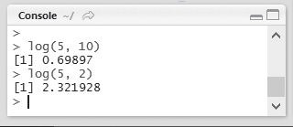
log(numeric) This function returns the natural logarithm (to base e) of a numeric value as shown in Fig. 6.26
The log function also allows us to provide an optional argument, which
explicitly change the base from e to any other base, as shown in Fig. 6.27
Fig. 6.26 Logarithm
Fig. 6.27 Logarithm to variable base

Slide 55
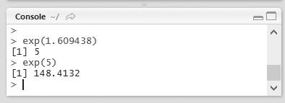
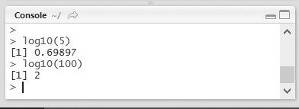
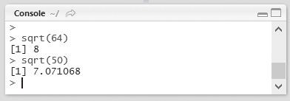
exp(numeric) This function is the inverse of the log function, or the antilog. The output is calculated at e raised to the power of the numeric value (refer to Fig. 6.28).
log10(numeric) This function returns the logarithm of the numeric value but with base 10.
sqrt(numeric) This function calculates the positive square root of the given numeric value.
Fig. 6.28 Antilog
Fig. 6.29 Logarithm to base 10
Fig. 6.30 Square root

Slide 56
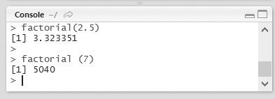
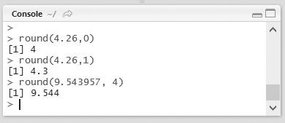
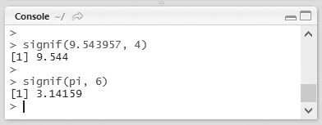
factorial(numeric) This function returns the factorial of a number.
round (numeric, digit) This function takes in two arguments—a numeric and the precision
(digits).
signif(numeric, digit) This function takes in two arguments again—a numeric value and the precision argument.
Fig. 6.31 Factorial
Fig. 6.32 Rounding off
Fig. 6.33 Significant digits

Slide 57
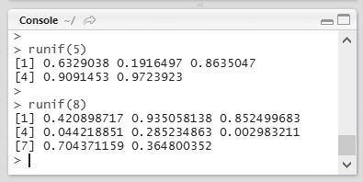
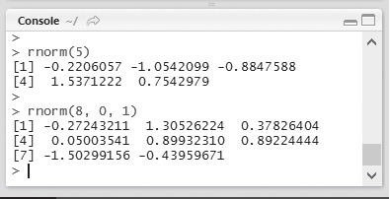
runif(numeric) This produces numeric number of uniform random numbers between 0 and 1.
rnorm(numeric) This produces numeric number of random numbers from a
normal distribution.
Fig. 6.34 Random number generator
Fig. 6.35 Random number generator from normal distribution
30

Slide 58
6.8 Cumulative Sums and Products
The cumulative functions in R provide a way of progressively calculating the sum or product of a sequence
cumsum(x)
cumprod(x)
Two interesting observations can be noted in the case of cumulative functions:
If the supplied object is a matrix, cumprod() using the column major approach to convert x into a vector.
If a data frame is sent as an argument, the function is applied only to each row.

Slide 59
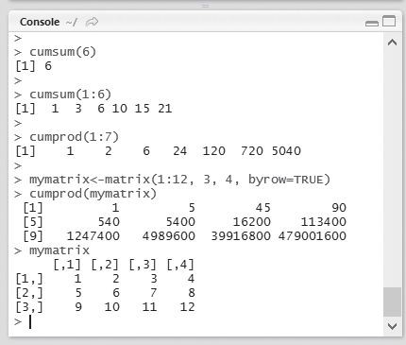
Fig. 6.37 Cumulative functions

Slide 60

6.9 Calculus in R
R has calculus capabilities for calculating derivative expressions and numerical
integration
Figure 6.38 demonstrates the use of the D() function in R to calculate the derivative of a simple function in R.
Fig. 6.38 Derivative calculation

Slide 61
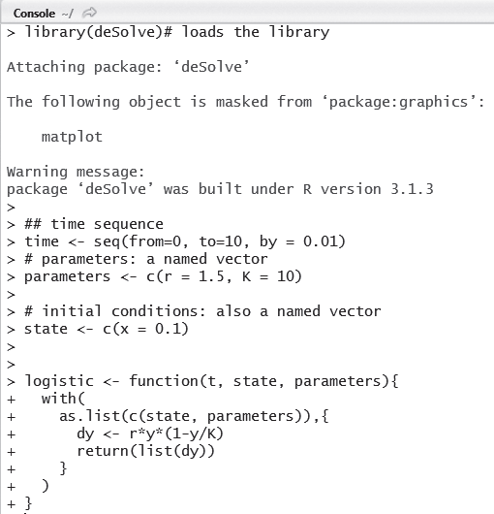
Fig. 6.39 Use of deSolve package

Slide 62

Using scan() Function
Fig. 6.42 Using scan() function

Slide 63

6.10 Input and Output Operations
Using readline() Function
readline (prompt = “ ”)
Fig. 6.41 Using readline() function

Slide 64

Displaying Output and Results
Function that can be used to produce output is the print() function, which is similar
to the I/O function in most other programming languages.
Fig. 6.43 Displaying results using print() function

